Slide 1
NBA Team Ranking Statistics Scraped
By,
Dev Dabbara
NYC Data Science Boot camp Project 2

Slide 2
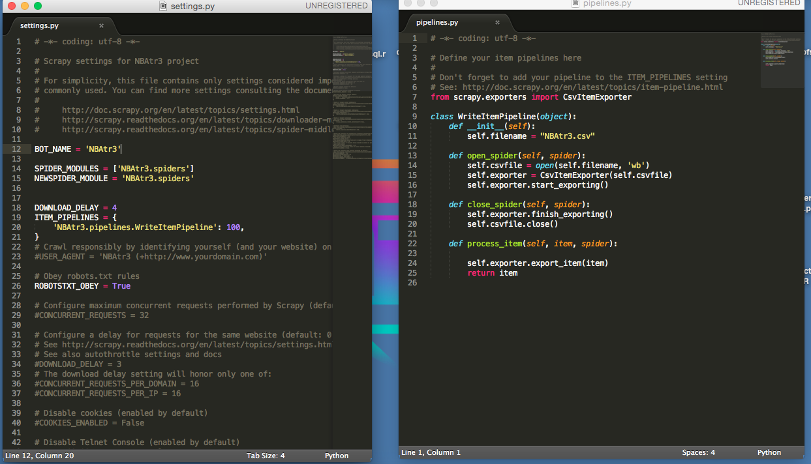
Scrapers

Slide 3
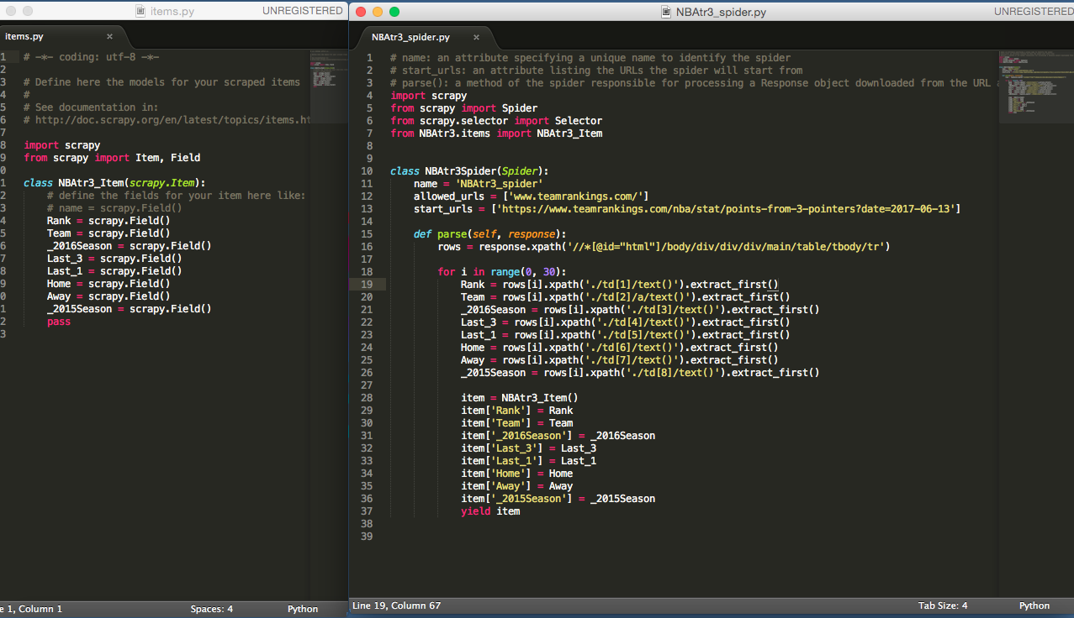
Scrapers

Slide 4
Data Collected
Scraper was used to scrape various statistics such as:
Avg4thQuarterMargin by each NBA team from 2016-2017 Season
Number of Fast Break Points by each NBA Team per Game
Each Team’s Average Points Per Game from the Three Point Line
Each Team’s Average Points Per Game from the Paint
Data Scraped Included:
-each teams current observed season average
-average of previous 3 games
-the teams most recent game
- previous season’s average.

Slide 5
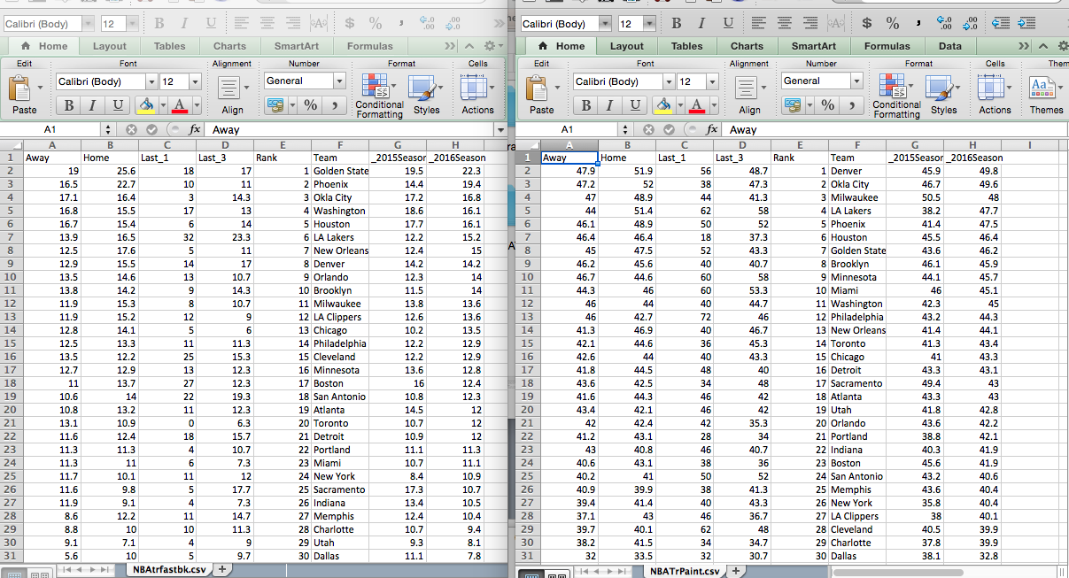
Resulting Csv Files

Slide 6
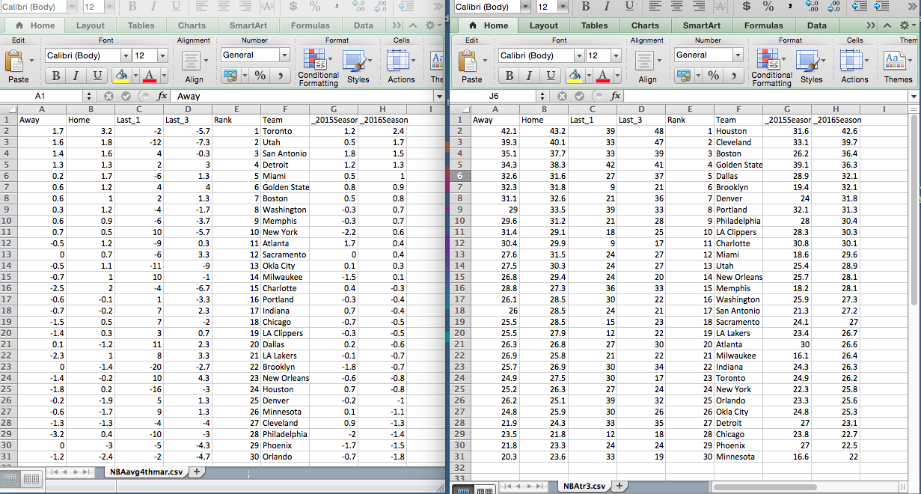
Resulting Csv Files

Slide 7
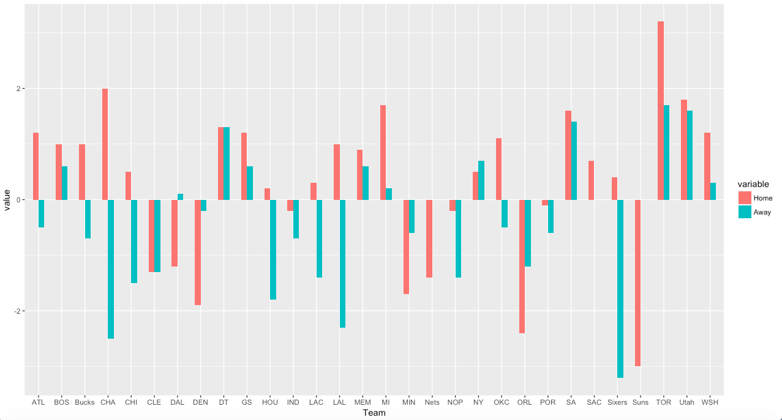
Data Findings

